Slide 1


Return-to-Work Programs
The Obvious (HARD SAVINGS)
Reduces medical, disability and rehabilitation cost.
Reduces the potential for litigation.
Speeds recovery time for injured worker.
Impacts insurance premiums.
The Not-So-Obvious (SOFT SAVINGS)
Improved morale and increased employee loyalty
Places experienced employees back on the premises
Discourages abuse of system
Provides sense of security, stability and connection to employer
Injured worker maintains full earning capacity
Injured worker keeps a productive mindset
Prevents injured workers from becoming dependent on disability system
Reinforces management’s commitment to their well being
Avoid the replacement and training costs of hiring a new employee
Identify cross-training opportunities that enhance employees in their regular jobs
Increase awareness of safe work practices and injury prevention
Copyright 2014 Brentwood Services Administrators, Inc. All Rights Reserved.

Slide 2
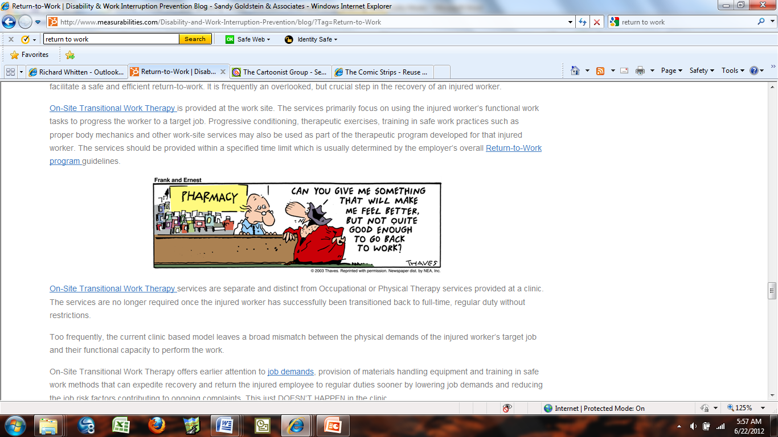
The goal of a safety program should be to eliminate accidents.
In the unfortunate event that an accident does occur your next best line of defense is a good return-to-work program.

Slide 3
Benefits of A Return-To-Work Program
The Obvious (HARD SAVINGS)
Reduces medical, disability and rehabilitation cost. (No Multipliers Applied)
Reduces the potential for litigation. (By as much as 50%)
Speeds recovery time for injured worker. (Return to full duty twice as fast)
Impacts insurance premiums. (Improve experience modifiers)
The Not-So-Obvious (SOFT SAVINGS)
Improved morale and increased employee loyalty
Places experienced employees back on the premises
Discourages abuse of system
Provides sense of security, stability and connection to employer
Injured worker maintains full earning capacity
Injured worker keeps a productive mindset
Prevents injured workers from becoming dependent on disability system
Reinforces management’s commitment to their well being
Avoid the replacement and training costs of hiring a new employee
Identify cross-training opportunities that enhance employees in their regular jobs
Increase awareness of safe work practices and injury prevention

Slide 4
Not all workers are alike but when it comes to accident statistics there are trends to consider.
Statistics About Injured Workers
Injured workers who are off work longer than six months have only a fifty percent chance of ever returning to their job; if time lost exceeds one year, their chances decrease to less than ten percent.
Companies that utilize return to work typically have lower experience modifiers and overall lower workers compensation cost.
Workers aged 55 and older are less likely to return to work and are out of work for longer periods after an injury than younger workers. When compared to workers between the ages of 25 and 39, the older workers are 25 percent less likely to return to work and are out of work 30-150 percent longer.
In 2012, there are 11 million more workers over the age of 55 in the U.S. labor force, creating unique demands on employers’ return to work programs.
The lack of a high school education impacts return to work, especially the length of time off work after the injury. Workers with a high school diploma return to work 10 to 16 weeks faster than high school dropouts. Especially affected were workers with only a grade school education. These workers were out of work 2 to 4.5 times longer than high school graduates.

Slide 5
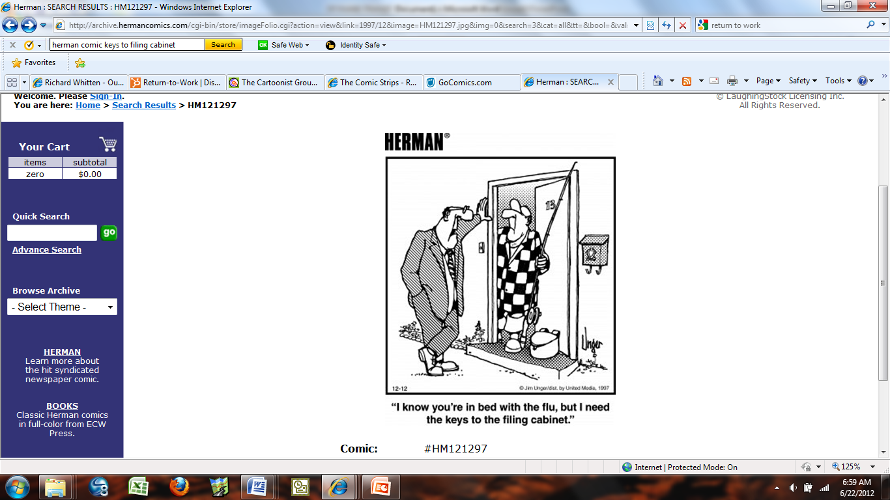
It’s a mindset that starts the first day an employee is hired!
Every employee and supervisor is a stakeholder in the return-to-work program.
Every employee and supervisor will have to be retrained in the way they view return-to-work, on the job accidents and work absences in general.

Slide 6
Bottom Line
It is true that by getting a worker back to work faster the overall expenses such as indemnity payments, medical cost and rehabilitation will be reduced. There is also the benefit of possibly avoiding a medical only claim converting to a lost time claim which will have an impact on the company’s overall experience rating.
Beyond the obvious benefits the questions most owners ask when considering return-to-work is “Why am I paying this worker full wages for less work?” or “Am I not fostering a culture that tells them they can still get full wages yet not have to work full time?”
The objective of a return-to-work program is to keep the injured employee part of the workforce or team while receiving the treatment necessary to recover to the point where he can resume his full duties. The employer could possibly have a period of reduced productivity, but this should be offset by avoiding the need to search for, hire, and train a replacement.
Additionally, a well implemented program will include continuous review of the modified duty so the employer has the flexibility to withdraw the offer if it is not working out for all involved. Again, the goal is not to create another class of employees who work in modified positions. The goal is to maintain the work connection for a limited period of time and then have the employee resume full duty status.

Slide 7
Will It Work at Your Business?
Like any other program it will pay back what you put into it. Simply developing a policy that your business recognizes return-to-work is not enough. It must be a coordinated effort between:
The owner
The management team
The treating physician
The employees
Improve your chances of having a successful return-to-work program:
Develop a return-to-work policy and communicate it to all new hires.
Work with your management team to educate them on the benefits of return-to-work and how the process should and should not work. Without the buy-in of your management team the return-to-work impact will be greatly reduced.
Establish a relationship with your treating physician or clinic. Have the treating physicians tour your facility to see the various jobs, their demands, and the work environment. The best return-to-work program will not produce the desired results if the injured employee does not treat with a physician who is willing to cooperate in the return-to-work effort.
Develop job descriptions listing demands, limitations, etc. Furnish these to your primary treating physician.
Develop job offers. Once a physician clears an injured worker for modified duty, present the worker with a description of the work he will perform and have him sign it. In the event he changes his mind or does not return to work, the offer can be retracted and in most cases the indemnity ceases.

Slide 8
Actual Cases – Pre-Reform Act
Return-to-work reduced this claim by $885.71
A 37 year old auto salesman stepped off the sidewalk and twisted his left knee. Investigation revealed a compensable injury by accident. Doctor ordered MRI as he suspected internal derangement, probable meniscus tear. Doctor put him on a narcotic pain medication and on light duty, requiring him to wear his brace and use crutches at work.
The employer, who has a fully implemented light duty program, said, "Our thinking is that if he will continue to be on pain medicine and crutches, then he will not be able to drive our vehicles as part of a customer demonstration. He can sit at a desk and continue to work with customers, but another salesperson or manager would need to drive the vehicle."
Savings--10 days between date of accident and scheduling of MRI and follow up appointment for results. Comp rate is $620. 10 days savings =$885.71.
Return-to-work reduced this claim by $1,552.28
A 43 year old technician who strained his shoulder while turning a wrench. Investigation revealed a compensable injury by accident. Doctor ordered 6 weeks of physical therapy and light duty with no overhead work for 4 weeks.
Employer placed him in a light duty position where he would not have to work on the lifted cars.
Savings--comp rate =$388.07 x 4 weeks=$1,552.28.
“It’s money being dangled right in front of you. Either you want it or you let someone else have it. It’s low hanging fruit”
Safety Manager

Slide 9
Actual Case – Pre-Reform Act
Return-to-work reduced this claim by $5,821.31
A 55 year old auto mechanic was removing an exhaust and felt a pop in his left shoulder. MRI revealed a rotator cuff tear and surgery was performed. Employee was off work from 10/11/11 - 03/06/12. Total Temporary Total Disability (TTD) paid for this period was $13,689.32.
Employee returned to work light duty on 03/07/12 at a reduced wage, therefore Temporary Partial Disability (TPD) benefits paid from 03/07/12 - 05/22/12. Total paid for this period was $1,300.42.
If no light duty position had been offered TTD benefits would have been issued from 03/07/12- 5/22/12 in the amount of $7,121.73.
The above reflects a total savings of $5,821.31 since a light duty job was offered.
“We implemented a return to work program last year and our overall claim cost dropped over 40%. I can’t believe we did not do this sooner.”
HR Manager

Slide 10
Actual Case – Pre-Reform Act
Return-to-work reduced this claim by $64,489.47
A 43 year old diesel technician injured his low back while servicing an ambulance. Investigation confirmed this to be a compensable injury. MRI of the lumbar spine revealed mild bilateral facet arthrosis. Light duty restrictions were provided by treating physician however there was no light work available at the dealership. Employee remained off work from 10/25/10 - 06/12/11. Total off work benefits paid during this time was $27,769.47.
Employer created a sit down job position as of 06/13/11 and TPD benefits were paid. Employee was able to work a few hours every day and his weekly pay was reduced from $841.50 a week to $755.71- Savings of $85.79 a week since a light duty job was offered.
Employee only worked 10 days of the light duty position as he voluntarily resigned as of 06/23/11 stating he was unable to perform the sit down position. Due to the employee resigning all WC indemnity benefits were stopped as of 06/22/11. The authorized physician placed the employee at maximum medical on 12/06/11.
Given the fact a light duty position was offered we saved $21,277.17 from 06/13/11-12/06/11. Since the employee voluntarily resigned, his PPD settlement would be considered as capped which also creates an additional savings. Employee was provided a 6% impairment to the body. Capped settlement= 6% x1.5x=9% to the body in the amount of $27,540.00
If there had not been return to work in this case, the PPD would have been 3.5x the rating. 6% x 3.5x=21% to the body in the amount of $64,260.00.
The indemnity settlement savings in this case would be $36,720.00.
Initiating a return-to-work program in this case created a total savings of $64,489.47.

Slide 11
Conclusion
Now that you see the benefits of a fully functional return-to-work program ,begin implementing one at your place of business.
If you already have a return to work program but after reading this feel your program is not up to speed then make the necessary adjustments.
Brentwood Services Administrators, Inc. is an industry leader in the area of adjusting workers compensation claims and loss prevention. We fully understand the importance of return to work programs. Contact our loss control department to learn more about return to work programs, their benefits and how to implement one.
Included with this article is a sample return-to-work program and the necessary forms you will need to begin your own program.
Copyright 2014 Brentwood Services Administrators, Inc. All Rights Reserved.

